Slide 1

Jarrell
Independent
School District
2Q22
Demographic Report

Slide 2
Local Economic Conditions

Slide 3
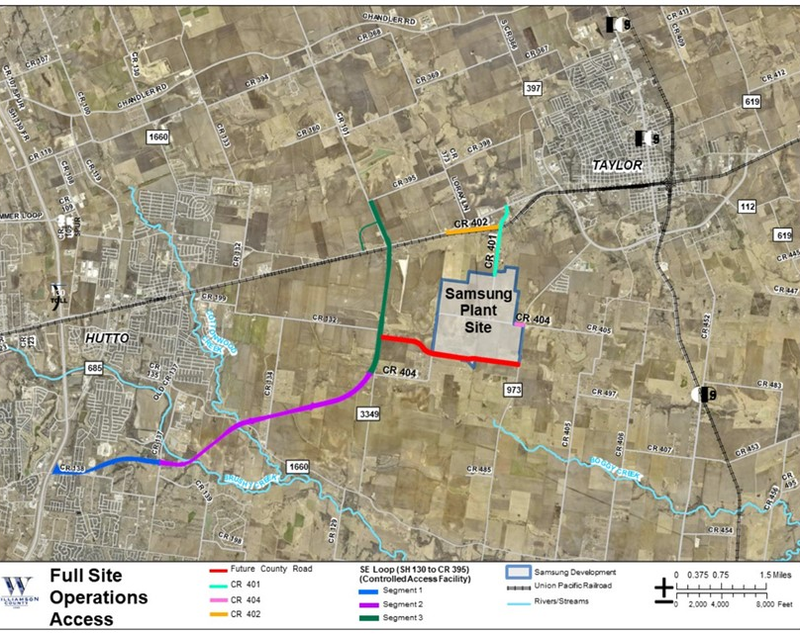
Local Economic Conditions
Samsung Semiconductor Chip-making Plant
Samsung has finalized plans to locate a $17 billion dollar semiconductor chip-making facility in Taylor, TX
The aim is to kick off construction in 2022, with a target of production start in the second half of 2024
The project will create over 2,000 high-tech jobs, thousands of indirect jobs, and a minimum of 6,500 construction jobs
The project will be among the largest single economic investments in Texas history and the largest single investment in the Austin area

Slide 4
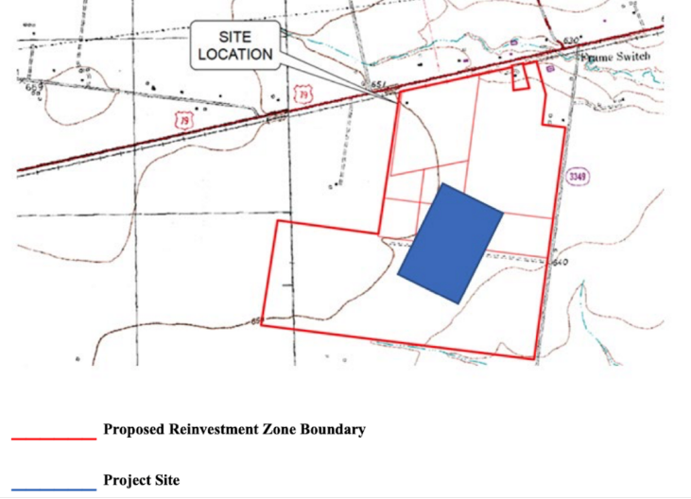
Local Economic Conditions
Applied Materials Chip-making Plant
Applied Materials is considering a $2 billion chip making factory in Hutto located on 450 acres near FM 3349 & US Hwy 79
The aim is to kick off construction in 1st quarter of 2023, with a target of completion in the second quarter of 2026. The plant anticipated to be operational by the end of 2026
The project will create over 800 jobs in fields of operations, robotics, engineering, computer science and administration
Should Applied Materials choose Hutto, it would reinforce the idea that the Austin area is becoming a new hub for critical tech in the US
Sources: Austin Business Journal
Notes:
Notes: Initial capital investment for “Project Acropolis” would start at $340 million and increase to $2 billion over a decade; average salary exceeding $100,000 plus benefits; Applied Materials sells their product to tech companies like Intel Corp & Samsung whose factory will be located to the east; “Project Acropolis” is seeking a Chapter 380 agreement with the city of Hutto that would provide roughly $80 million in incentives over the next 10 years (includes reimbursement for infrastructure – including water, wastewater and road construction – plus a potential tax abatement, the creation of tax increment reinvestment zone and a sales tax sharing agreement)(Source: Austin Business Journal)
Skybox Datacenters & Prologis- purchasing over 200 acres in Hutto to build massive datacenter, still in process of finalizing development plans; Skybox & Prologis are also working together to build $548 million datacenter in Pflugerville, ground breaking occurred in June 2022, spans 141,000 sq. ft. and received a 10-year incentive agreement from Pflugerville Community Development Corp that gives expansion grant of up to $1.575 million, finance deal requires the companies to construct the facility prior to Jan 1, 2024 and secure at least 1 tenant & have a minimum investment of $50 million (Source: Austin American-Statesman)

Slide 5
Austin New Home Ranking Report
ISD Ranked by Annual Closings – 2Q22
Rank | District Name | Annual Starts | Annual Closings | Inventory | VDL | Futures
1 | LEANDER ISD | 2,816 | 2,460 | 1,958 | 2,416 | 6,648
2 | HAYS CISD | 3,532 | 2,328 | 2,708 | 3,884 | 42,402
3 | GEORGETOWN ISD | 3,107 | 2,286 | 2,374 | 3,487 | 14,970
4 | LIBERTY HILL ISD | 2,400 | 1,977 | 1,819 | 2,315 | 10,169
5 | HUTTO ISD | 1,873 | 1,530 | 1,143 | 1,120 | 10,149
6 | PFLUGERVILLE ISD | 1,152 | 1,371 | 899 | 1,014 | 8,855
7 | JARRELL ISD* | 1,430 | 1,122 | 765 | 1,335 | 13,076
8 | AUSTIN ISD | 2,212 | 1,008 | 2,576 | 1,257 | 10,275
9 | DEL VALLE ISD | 1,095 | 919 | 890 | 1,233 | 23,499
10 | DRIPPING SPRINGS ISD | 1,050 | 859 | 854 | 765 | 7,849
11 | MANOR ISD | 1,457 | 787 | 1,225 | 1,476 | 14,345
12 | BASTROP ISD | 1,042 | 775 | 635 | 2,649 | 16,606
13 | LAKE TRAVIS ISD | 705 | 656 | 726 | 792 | 4,061
14 | SAN MARCOS CISD | 1,062 | 517 | 846 | 847 | 5,579
15 | ROUND ROCK ISD | 822 | 479 | 760 | 838 | 5,229
16 | ELGIN ISD | 485 | 354 | 311 | 561 | 8,981
17 | TAYLOR ISD | 246 | 223 | 140 | 200 | 1,035
18 | LAGO VISTA ISD | 296 | 197 | 254 | 369 | 3,984
19 | LOCKHART ISD | 67 | 57 | 59 | 250 | 19,051
20 | WIMBERLEY ISD | 14 | 19 | 12 | 56 | 0
* Based on additional Templeton Demographics housing research
**Includes Age-Restricted subdivisions

Slide 6
1 Year Change in District Housing
 | 2Q21 | 2Q22 | Difference
Annual Starts | 1,143 | 1,430 | +287
Quarterly Starts | 339 | 413 | +74
Annual Closings | 894 | 1,122 | +228
Quarterly Closings | 263 | 409 | +146
Under Construction | 451 | 627 | +176
Inventory | 502 | 765 | +263
VDL | 770 | 1,335 | +565
Futures | 12,756 | 13,076 | +320

Slide 7
District Housing Overview by Elementary Zone
Elementary | Annual Starts | Quarter Starts | Annual Closings | Quarter Closings | Under Construction | Inventory | Vacant Dev. Lots | Futures
IGO | 1,000 | 333 | 445 | 244 | 546 | 640 | 1,023 | 9,721
JARRELL | 430 | 80 | 677 | 165 | 81 | 125 | 312 | 3,355
Grand Total | 1,430 | 413 | 1,122 | 409 | 627 | 765 | 1,335 | 13,076

Slide 8
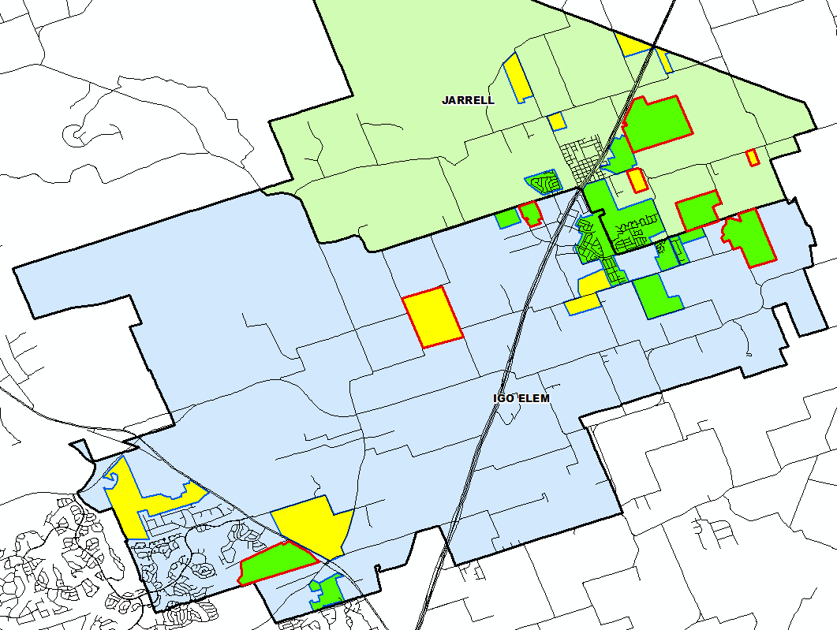
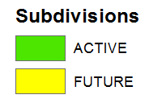

District Housing Overview
The district has 15 actively building subdivisions
Within JISD there are 12 future subdivisions
Of these, groundwork is underway on 1,480 lots within 8 subdivisions

Slide 9
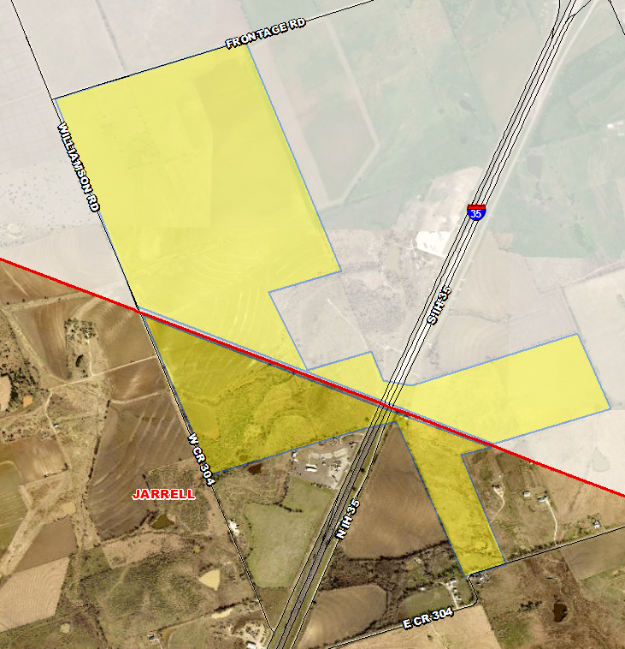
Residential Activity
Future Mixed-Use
Approx. 200 total future lots, based on acreage
A 445-acre master-planned community with I-35 frontage commercial/retail and two multi-family complexes
Entire development to include 1,200+ single family homes and a future elementary school site
Developer: HighTen Development
Split between JISD and Salado ISD
Split between Williamson and Bell County
Jarrell Elementary
SALADO ISD

Slide 10
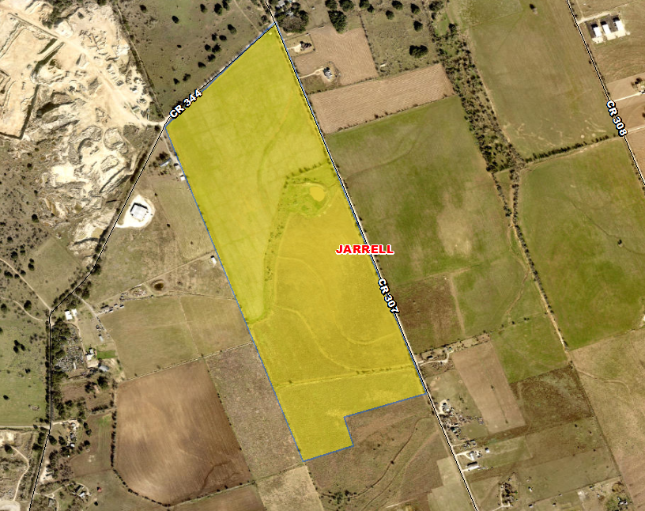
Residential Activity
Hunter’s Glen
413 total future lots
Williamson County MUD
Developer: Countryview of Red Oak LLC
Jarrell Elementary

Slide 11
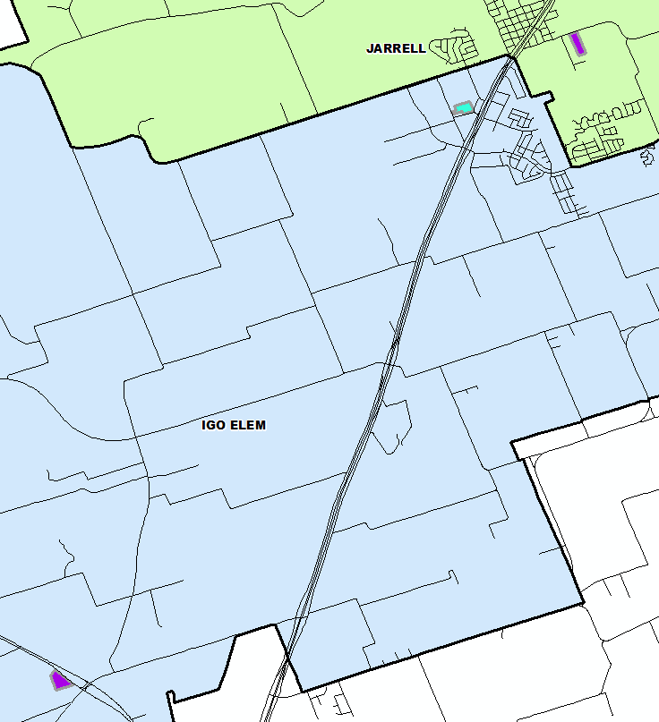
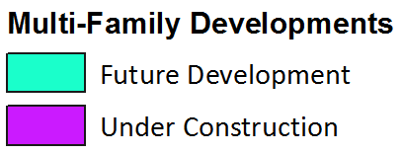
Multi-Family Housing Overview
There are currently 368 units under construction in the district
Within Jarrell ISD there are roughly 80 future age-restricted multi-family units in the planning stages

Slide 12
Ten Year Forecast by Grade Level
Year (Oct.) | EE | PK | K | 1st | 2nd | 3rd | 4th | 5th | 6th | 7th | 8th | 9th | 10th | 11th | 12th | Total | Total Growth | % Growth
2018/19 | 13 | 89 | 142 | 153 | 154 | 138 | 144 | 146 | 141 | 129 | 142 | 136 | 126 | 122 | 121 | 1,896
2019/20 | 5 | 113 | 174 | 164 | 171 | 161 | 168 | 159 | 159 | 169 | 143 | 172 | 125 | 120 | 104 | 2,107 | 211 | 11.1%
2020/21 | 4 | 87 | 182 | 198 | 181 | 171 | 170 | 184 | 167 | 170 | 176 | 183 | 177 | 137 | 118 | 2,305 | 198 | 9.4%
2021/22 | 6 | 151 | 224 | 241 | 244 | 222 | 219 | 209 | 208 | 209 | 193 | 221 | 192 | 205 | 141 | 2,885 | 580 | 25.2%
2022/23 | 21 | 200 | 277 | 276 | 292 | 301 | 270 | 270 | 259 | 262 | 255 | 259 | 232 | 221 | 209 | 3,604 | 719 | 24.9%
2023/24 | 23 | 235 | 336 | 338 | 325 | 350 | 361 | 326 | 329 | 316 | 314 | 332 | 272 | 248 | 221 | 4,326 | 722 | 20.0%
2024/25 | 23 | 265 | 381 | 395 | 382 | 368 | 394 | 419 | 394 | 401 | 379 | 408 | 340 | 269 | 243 | 5,061 | 735 | 17.0%
2025/26 | 23 | 280 | 440 | 445 | 461 | 442 | 426 | 458 | 457 | 450 | 431 | 498 | 418 | 337 | 264 | 5,830 | 769 | 15.2%
2026/27 | 23 | 310 | 498 | 519 | 503 | 521 | 507 | 495 | 499 | 503 | 488 | 562 | 510 | 414 | 330 | 6,682 | 852 | 14.6%
2027/28 | 23 | 350 | 555 | 583 | 582 | 561 | 589 | 573 | 532 | 544 | 545 | 586 | 551 | 505 | 406 | 7,485 | 803 | 12.0%
2028/29 | 23 | 370 | 611 | 643 | 637 | 631 | 617 | 648 | 616 | 580 | 588 | 694 | 604 | 545 | 495 | 8,302 | 817 | 10.9%
2029/30 | 23 | 400 | 656 | 703 | 691 | 692 | 694 | 679 | 697 | 671 | 628 | 740 | 702 | 598 | 534 | 9,108 | 806 | 9.7%
2030/31 | 23 | 400 | 705 | 739 | 755 | 750 | 761 | 764 | 730 | 760 | 726 | 781 | 745 | 695 | 586 | 9,920 | 812 | 8.9%
2031/32 | 23 | 400 | 742 | 794 | 779 | 820 | 825 | 837 | 821 | 796 | 823 | 914 | 794 | 738 | 681 | 10,787 | 867 | 8.7%
2032/33 | 23 | 402 | 781 | 836 | 837 | 846 | 902 | 908 | 900 | 895 | 862 | 1,032 | 925 | 786 | 723 | 11,658 | 871 | 8.1%
Yellow box = largest grade per year
Green box = second largest grade per year

Slide 13
Ten Year Forecast by Campus
 |  |  | Fall | ENROLLMENT PROJECTIONS
Campus | Capacity | 2021/22 | 2022/23 | 2023/24 | 2024/25 | 2025/26 | 2026/27 | 2027/28 | 2028/29 | 2029/30 | 2030/31 | 2031/32 | 2032/33
Igo Elementary | 800 | 845 | 1,031 | 1,250 | 1,476 | 1,725 | 2,021 | 2,344 | 2,609 | 2,869 | 3,118 | 3,351 | 3,562
Jarrell Elementary | 608 | 671 | 876 | 1,044 | 1,151 | 1,250 | 1,355 | 1,472 | 1,571 | 1,669 | 1,779 | 1,869 | 1,973
ELEMENTARY SCHOOL TOTAL | 1,408 | 1,516 | 1,907 | 2,294 | 2,627 | 2,975 | 3,376 | 3,816 | 4,180 | 4,538 | 4,897 | 5,220 | 5,535
Elementary Absolute Change |  | 339 | 391 | 387 | 333 | 348 | 401 | 440 | 364 | 358 | 359 | 323 | 315
Elementary Percent Change |  | 28.80% | 25.79% | 20.29% | 14.52% | 13.25% | 13.48% | 13.03% | 9.54% | 8.56% | 7.91% | 6.60% | 6.03%
Jarrell Middle School | 764/1,004 | 610 | 776 | 959 | 1,174 | 1,338 | 1,490 | 1,621 | 1,784 | 1,996 | 2,216 | 2,440 | 2,657
MIDDLE SCHOOL TOTAL |  | 610 | 776 | 959 | 1,174 | 1,338 | 1,490 | 1,621 | 1,784 | 1,996 | 2,216 | 2,440 | 2,657
Middle School Absolute Change |  | 97 | 166 | 183 | 215 | 164 | 152 | 131 | 163 | 212 | 220 | 224 | 217
Middle School Percent Change |  | 18.91% | 27.21% | 23.58% | 22.42% | 13.97% | 11.36% | 8.79% | 10.06% | 11.88% | 11.02% | 10.11% | 8.89%
Jarrell High School | 995/1,258 | 759 | 921 | 1,073 | 1,260 | 1,517 | 1,816 | 2,048 | 2,338 | 2,574 | 2,807 | 3,127 | 3,466
HIGH SCHOOL TOTAL |  | 759 | 921 | 1,073 | 1,260 | 1,517 | 1,816 | 2,048 | 2,338 | 2,574 | 2,807 | 3,127 | 3,466
High School Absolute Change |  | 144 | 162 | 152 | 187 | 257 | 299 | 232 | 290 | 236 | 233 | 320 | 339
High School Percent Change |  | 23.41% | 21.34% | 16.50% | 17.43% | 20.40% | 19.71% | 12.78% | 14.16% | 10.09% | 9.05% | 11.40% | 10.84%
DISTRICT TOTALS |  | 2,885 | 3,604 | 4,326 | 5,061 | 5,830 | 6,682 | 7,485 | 8,302 | 9,108 | 9,920 | 10,787 | 11,658
District Absolute Change |  | 580 | 719 | 722 | 735 | 769 | 852 | 803 | 817 | 806 | 812 | 867 | 871
District Percent Change |  | 25.16% | 24.92% | 20.03% | 16.99% | 15.19% | 14.61% | 12.02% | 10.92% | 9.71% | 8.92% | 8.74% | 8.07%

Slide 14
Key Takeaways
Austin MSA continues to be one of the fastest growing area in the US with multiple tech factories moving into the area
The district has 15 actively building subdivisions and 12 future subdivisions in the planning stages
Groundwork is underway on nearly 1,480 lots within 7 subdivisions
JISD may enroll over 6,600 students by 2026/27 and approx. 10,700 students by 2031/32

